Slide 1
Understanding Emotional Intelligence

Slide 2
EI = Emotional Intelligence
The ability to recognize and manage:
  Moods
  Emotions
  Attitudes
Research shows a connection between a student’s EI and success in college.

Slide 3
What makes up your EI?
Understanding emotions:
  Label feelings accurately
  Determine why you feel the way you do
  Predicting how others might respond in a given situation
Managing emotions:
  Feelings can be changed, improved.
  Learn from them and how to take appropriate action

Slide 4

Bar-On Model of Emotional Intelligence
Intrapersonal Skills – how well you know and like yourself – staying happy:
  Emotional Self-Awareness
  Assertiveness
  Independence
  Self-Regard
  Self-Actualization

Slide 5

Bar-On Model of Emotional Intelligence…continued
Interpersonal Skills – Forging relationships and getting along with people:
  Empathy
  Social Responsibility
  Interpersonal Relationships

Slide 6

Bar-On Model of Emotional Intelligence…continued
Adaptability – the ability to adjust to unexpected situations:
  Reality Testing
  Flexibility
  Problem Solving

Slide 7
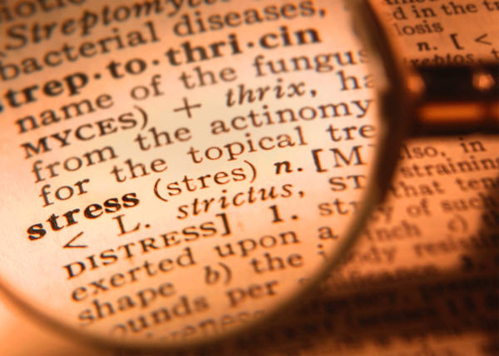
Bar-On Model of Emotional Intelligence…continued
Stress Management – dealing with pressures and demands:
  Stress Tolerance
  Impulse Control

Slide 8
Bar-On Model of Emotional Intelligence…continued
General Mood and Effective Performance – having a positive attitude:
  Optimism
  Happiness

Slide 9
How Your Emotions Can Affect Your Success
Emotionally Intelligent students get higher grades
Students who can’t manage their emotions struggle academically
Students who can delay gratification tend to do better overall

Slide 10

Improving Your EI
Identify your strengths and weaknesses.
Set realistic goals.
Formulate a plan.
Check your progress regularly.

